Slide 1
TestRail
3rd Party Tool Brief
Target Audience: SE / GSA Team

Slide 2
TestRail Structure

Slide 3
Common Artifacts
There are two modules that ConnectALL can interact with.
Both will be introduced in this presentation, and work together.
Test Plan
Test Lab

Slide 4
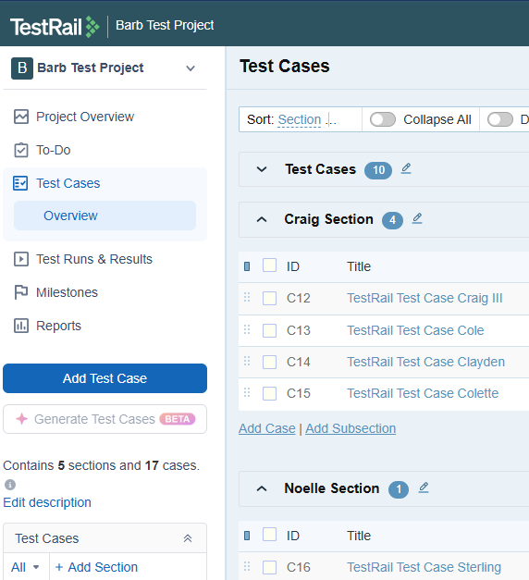
Test Plan
This depicts a Barb Test Project, with 3 Sections (the Suite can not be seen here).
The Test Cases section has 10 Test Cases, the Craig Section has 4 Test Cases, and the Noelle Section has 1 Test Case.
A Suite is the highest level under a project (default one will be created)
Sections are meant to group Test Cases. (default Test Cases will be created)
Test Cases These are grouped under the Test Case Sections and reused within the Tests of the Lab.

Slide 5
Test Lab
Test Plans are the highest level for the testing.
Tests are executed within Runs which fall under the Project or a Test Plan.
ConnectAll currently can only work with the Runs under the Project.
Runs are a selection of Test Cases.
Tests are grouped within a Run and have links to the Test Cases.
The execution of a Test Run is against the Test.
Test Results lie within the Tests

Slide 6
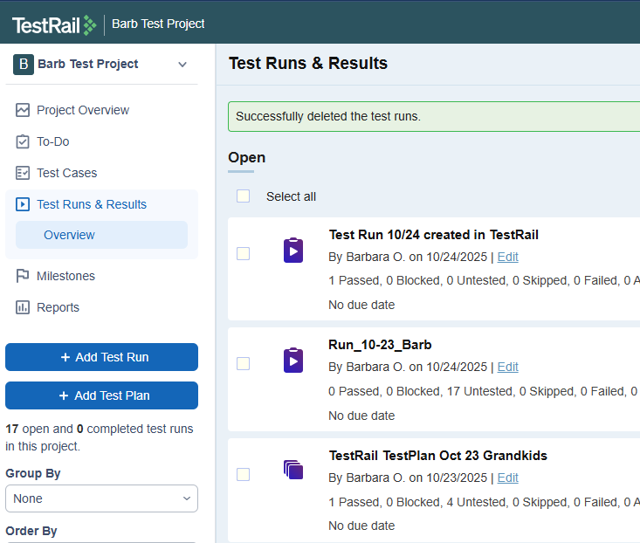
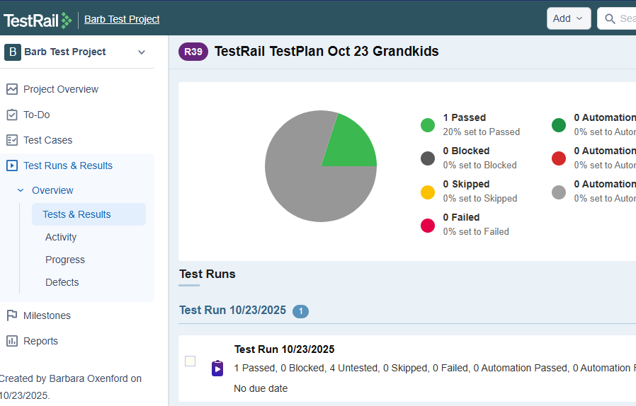
Test Lab
This depicts a Barb Test Project, with 2 Test Runs within the Project and One Test Plan (Grandkids).
The Test Plan has one Test Run within it.

Slide 7
Example Scenarios

Slide 8
TestRail-ALM Test Plan Alignment
TestRail
ALM
Suite
Test Case Folder
Section
Test Case Folder
Test Case
Test Case
Test Config

Slide 9
TestRail-ALM Test Lab Alignment
TestRail
ALM
Test Plans
Test Set Folder
Runs
Test Set
Tests
Test Instance
Test Results
Test Run
Run Steps

Slide 10
Alignment with available API calls
TestRail Test Plan ALM Test Plan
1 Suite (get_suites/project) Test Case Folder (test-folders)
2 Section (get_sections/project) Test Case Folder (test-folders)
3 Test Case (get_cases/project) Test Case (tests)
Test Config
TestRail Test Lab ALM Test Lab
4 Test Plans (get_plans(project)) Test Set Folder (test-set-folders)
5 Runs (runs(project)/get_plan(plan_id)) Test Set (test-sets) (known as Cycle)
6 Tests (tests/(run_id))(link from Test Case) Test Instance (test-instances)(link from Test Case)
* Test Results Test Run (runs)
(get_results_for_run/(run_id or case)) or (get_results(test_id)) Run Steps
*Note: ConnectAll does not sync Test Runs and TestRail Test Results

Slide 11
Setting Up Automations
Configuring Specific Scenarios in ConnectALL
Target Audience: SE / GSA Team

Slide 12
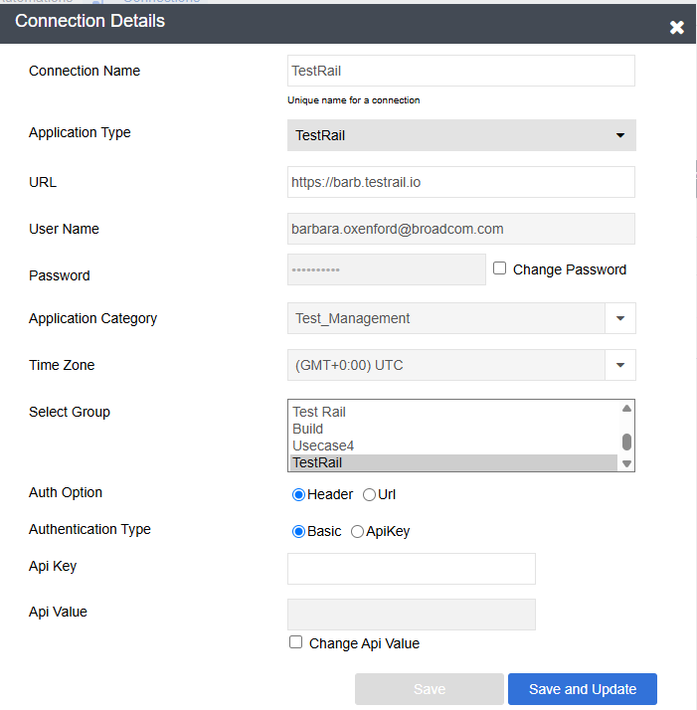
Creating a Connection
User Name and Password is required.
Your connection’s time zone will need to match the time zone of your TestRail server.
The adapter supports Basic Auth.

Slide 13
Testing Sync

Slide 14
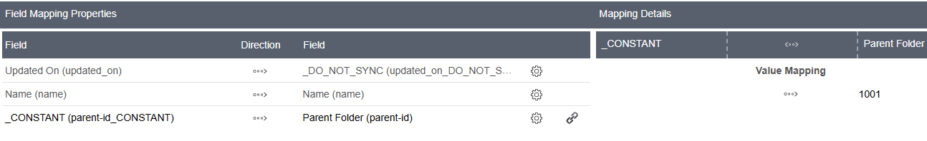
Automation Setup (Suite or Section to Test Case Folder)
The typical creation flow is TestRail -> ALM.
To create a Test Case Folder in ALM, the following fields are required:
Name
Updated On to search for changes
Project Id as a CONSTANT
In the below mapping, the Project Id is 1001
Additional fields can be mapped as desired.

Slide 15
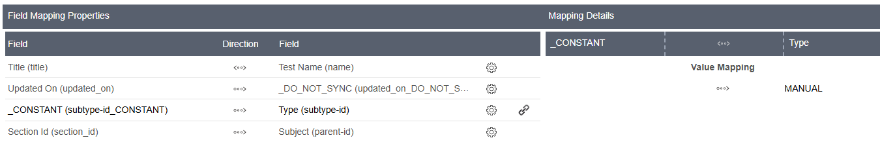
Automation Setup (Test Cases)
The typical creation flow is TestRail -> ALM.
To create a Test Case in ALM, the following fields are required:
Name
Updated On to search for changes
CONSTANT of MANUAL as Type (subtype-id)
Section Id to Subject (parent-id)
Enable Translate Record Id and choose the Section to TestCase Folder Automation on both sides
Additional fields can be mapped as desired.

Slide 16
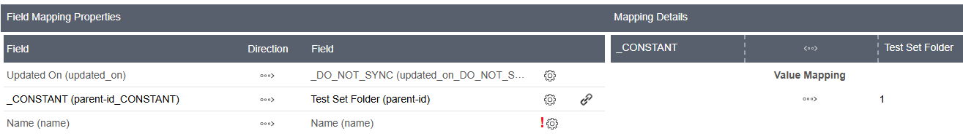
Automation Setup (Test Plan to Test Set Folder)
The typical creation flow is TestRail -> ALM.
To create a Test Set Folder in ALM, the following fields are required:
Name
Updated On to search for changes
Parent-id/Test Set Folder as a CONSTANT
In the below mapping, the Test Set Folder is 1
Additional fields can be mapped as desired.

Slide 17
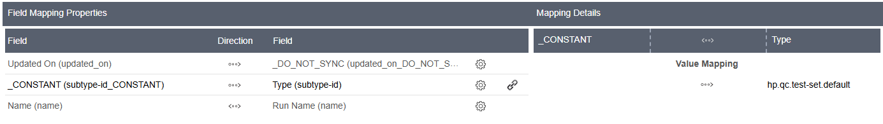
Automation Setup (Runs to Test Set )
The typical creation flow is TestRail -> ALM.
To create a Test Set in ALM, the following fields are required:
Name
Updated On to search for changes
Type as a CONSTANT
Additional fields can be mapped as desired.
In the below mapping, the Test Set Type is hp.qc.test-set.default

Slide 18
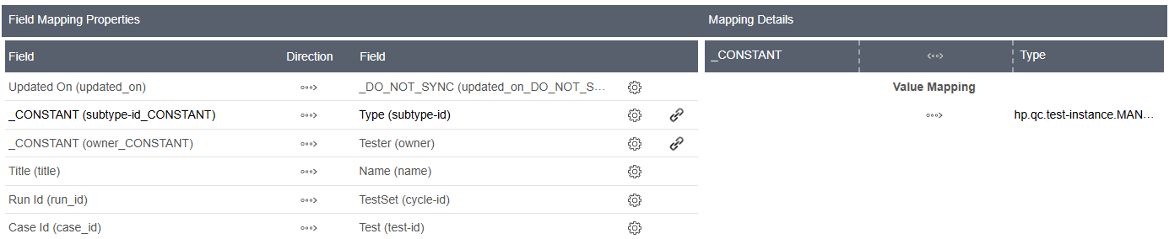
Automation Setup (Tests to Test Instance)
The typical creation flow is TestRail -> ALM.
To create a Test Instance in ALM, the following fields are required:
TestRail Title to Name
Updated On to search for changes
Type as a CONSTANT
Run Id to TestSet (cycle-id)
Enable Translate Record Id, choosing the Run to TestSet Automation on both sides
Case Id to Test (test-id)
Enable Translate Record Id,choosing the Tests to Test Instance on both sides
In the below mapping, the Typed is hp.qc.test-instance.MANUAL
Additional fields can be mapped as desired.

Slide 19
TestRail Tips

Slide 20
Common Errors

Slide 21
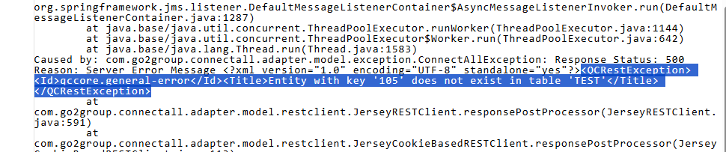
Reading Errors
The error message from TestRail is not always clear upon initial review… if you don’t know where to look.
On the ConnectALL Dashboard, expand the error, click the eye, and scroll down. Look for the “QCRestException” error.
The below error is when a record has been deleted.

Slide 22
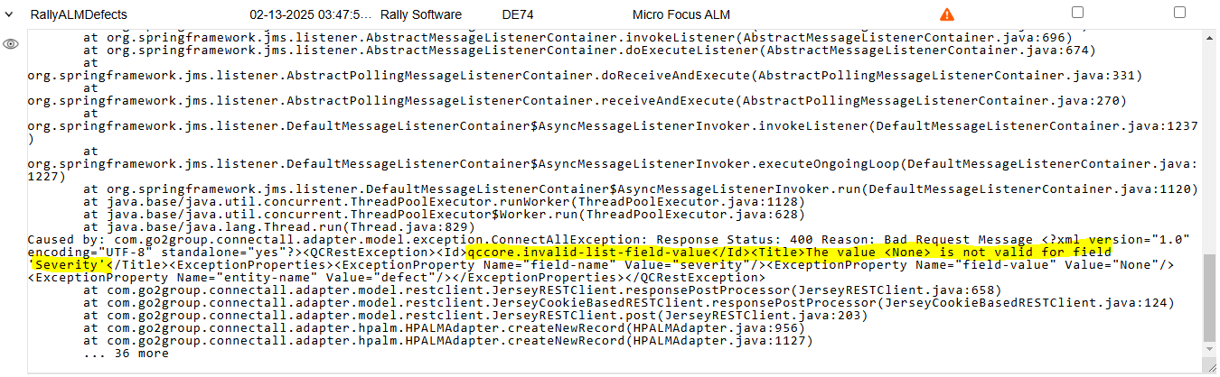
Missing Value Mapping
The below error is common across all adapters, but is included below so you know what to look for with TestRail.
In this scenario, a value mapping was not defined for the “None” or “Empty” option for Severity.
To solve this, make sure all options are mapped in the Value Mapping.

Slide 23
Missing Required Field
This error means that ConnectALL tried to sync a create or update into TestRail, but a field was missing.
This can happen for all entity types, but is very common.
To solve this in general, make sure all required fields are mapped. To solve the exact error below, make sure the Requirement Type is mapped. (Simply an example,although this field isn’t relevant for TestRail.)

Slide 24
Useful APIs for Digging Deep

Slide 25
Test Plan
All the following are Get by Project Id (1 is the Project Id used here)
GET Suite
https://{base_url}/index.php?/api/v2/get_suites/1
GET Sections
https://{base_url}/index.php?/api/v2/get_sections/1
GET Test Cases
https://{base_url}/index.php?/api/v2/get_cases/1

Slide 26
Test Lab
GET Test Plans (by Project id, 1 is the Project used here)
https://{base_url}/index.php?/api/v2/get_plans/1
GET Runs (by Project id, 1 is the Project used here)
https://{base_url}/index.php?/api/v2/get_runs/1 OR
https://{base_url}/index.php?/api/v2/get_plan/{plan_id} which will return the Plan with all it’s associated Runs
GET Tests
https://{base_url}/index.php?/api/v2/get_tests/{run_id}
GET Test Results (which would match to Test Run in ALM)
https://{base_url}/index.php?/api/v2/get_results_for_run/{run_id} OR get_results_for_case/{case_id}
https://{base_url}/index.php?/api/v2/get_results/{test_id}

